Slide 1


Slide 2
OXYGEN DELIVERY SYSTEMS
H.Moeini .MD
Anesthesiologist
Pediatric Anesthesia Fellowship

Slide 3
Introduction
Oxygen therapy is critical for patient recovery in the PACU.
Selecting the right oxygen delivery system is essential.
Factors include type of surgery, patient condition
Effective oxygenation reduces complications and supports healing.

Slide 4
Considerations for Post-Surgery Oxygen Delivery
The oxygen delivery system of choice :
  Degree of hypoxemia
  Surgical procedure
  Patient compliance
Oxygen should be humidified
Patients who have just undergone head and neck surgery:
  may not be candidates for face mask
  nasal packing prohibits the use of nasal cannulas
Individualized approach ensures patient safety.
Notes:
Regardless of the delivery system, oxygen should be humidified in order to prevent the subsequent dehydration of the nasal and/or oral mucosa if possible
may not be candidates for face mask oxygen because of the risk of pressure necrosis on incision sites and microvascular muscle flaps, whereas nasal packing prohibits the use of nasal cannulas in others
In an elderly patient, or one who is at an increased risk of delirium: nasal cannula may be selected over a face mask, as long as their oxygenation saturation levels are adequate

Slide 5
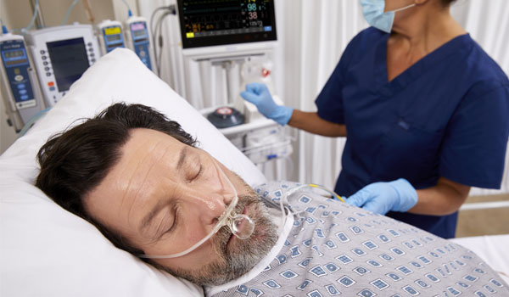
Supplemental Oxygen in the PACU
Hypoxemia is common post-surgery due to anesthesia effects.
Oxygen therapy tailored to patient's needs ensures proper saturation.
Common causes: atelectasis, pain, residual anesthesia.
Close monitoring helps adjust oxygen delivery as needed.

Slide 6
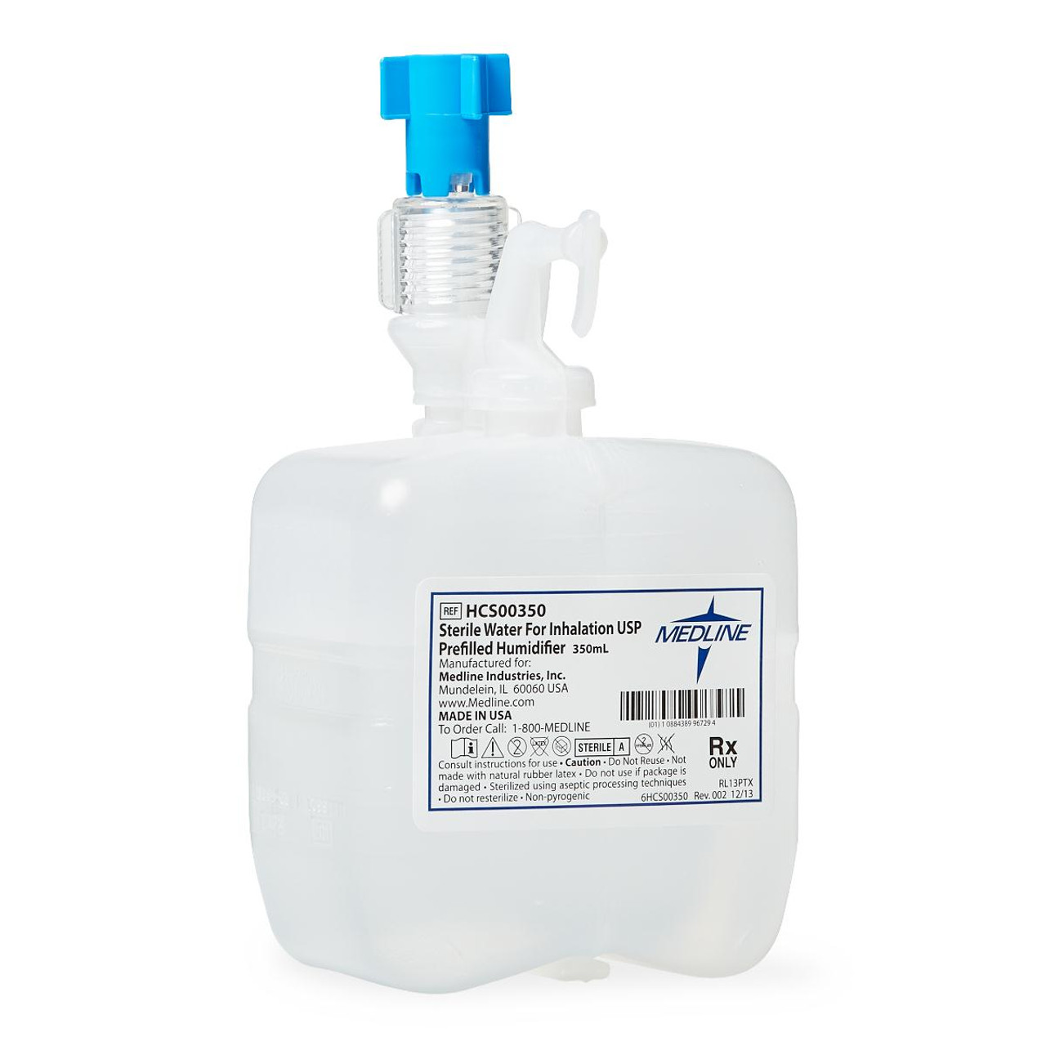
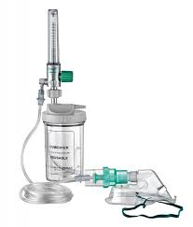
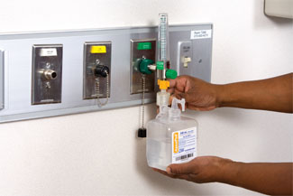
Importance of Humidification
Dry oxygen can irritate nasal and oral mucosa.
Humidification prevents discomfort, especially with prolonged use.
Recommended for patients requiring high-flow oxygen therapy.
Enhances patient comfort and reduces mucosal dryness.

Slide 7
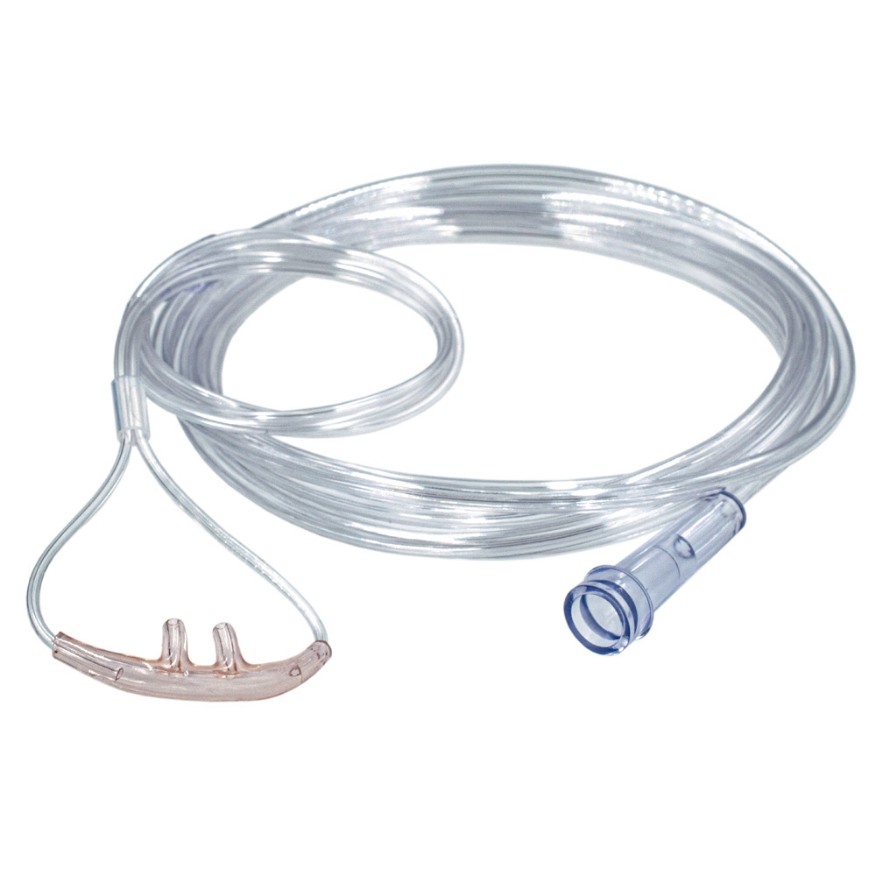
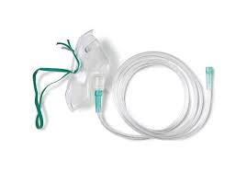
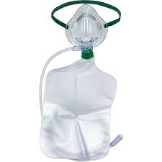
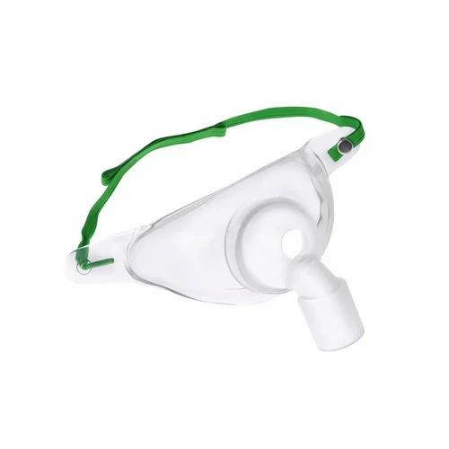
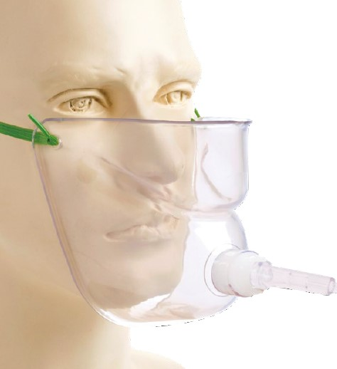
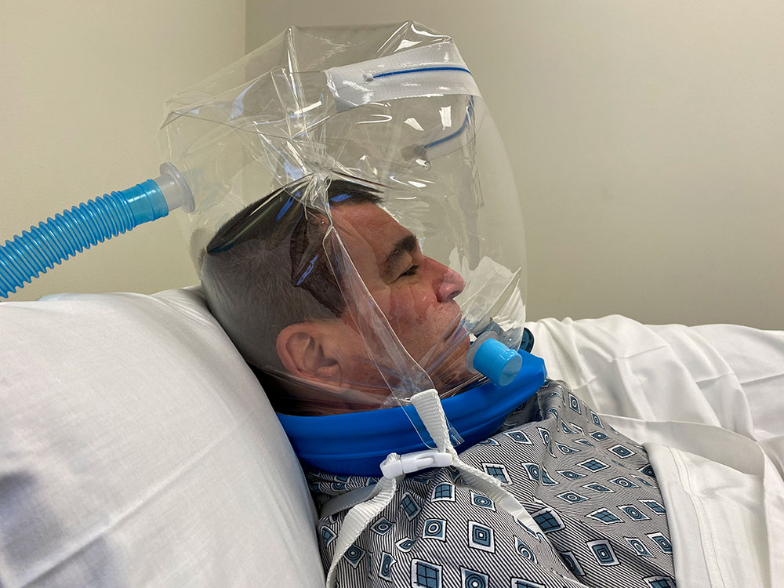
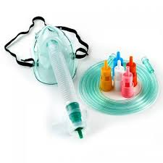
oxygen delivery devices

Slide 8
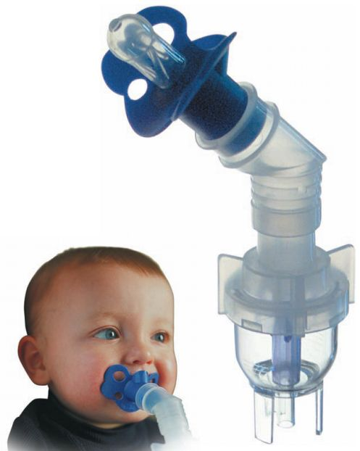
Alternative Oxygen Delivery Options
Face tents: Provide oxygen without pressure on the face.
Blow-by setups: Deliver oxygen near the face without direct contact.
Useful for facial trauma or grafts where masks can't be used.
Maintain adequate FiO₂ levels without discomfort.

Slide 9
Blow-by setups
O2% : 30% to 40%, depending on the flow rate and proximity of the oxygen source to the child's face.
Notes:
Effectiveness and Limitations of Oxygen Therapy Using the Blow-by Method
Advantages:
Non-invasive and well-tolerated: Ideal for infants or young children who may become agitated or distressed with masks or cannulas.
Convenient: Useful in emergency or temporary situations where a mask or nasal cannula may not be feasible.
Limitations:
Uncontrolled oxygen delivery: Due to the open-air nature of the method, it is difficult to control the exact concentration of oxygen the patient receives.
Inefficient for severe hypoxemia: The Blow-by method is generally not effective for children with significant respiratory distress or low oxygen saturation levels due to its limited ability to deliver high oxygen concentrations.
Not recommended for long-term use: It is often considered a temporary solution or a last resort when more effective oxygen delivery methods are not tolerated by the child.
Effects of Oxygen Therapy on Children
Oxygen therapy can be critical for children experiencing conditions like respiratory distress, pneumonia, asthma, bronchiolitis, or other forms of hypoxemia. The effects of oxygen therapy include:
Improved Oxygen Saturation: Oxygen therapy can increase blood oxygen levels, reducing the risk of hypoxemia and related complications.
Reduced Respiratory Effort: By increasing the oxygen available, it can decrease the work of breathing and reduce fatigue, especially in children with respiratory distress.
Stabilization of Vital Signs: It helps in normalizing heart rate and blood pressure, especially in critically ill children.
Improved Tissue Oxygenation: Enhances oxygen delivery to vital organs, preventing tissue damage due to hypoxia.
However, excessive oxygen therapy or prolonged use can be harmful, particularly in neonates, potentially leading to oxygen toxicity or conditions like retinopathy of prematurity. Therefore, oxygen therapy in children should always be carefully monitored and adjusted to achieve target oxygen saturations.

Slide 10
Elderly Patients & Oxygen Delivery
In an elderly patient, or one who is at an increased risk of delirium: nasal cannula
Nasal cannulas reduce anxiety and confusion compared to masks.
Suitable for elderly patients with cognitive challenges.
Ensures comfort while maintaining adequate oxygenation.
Frequent monitoring of SpO₂ levels is necessary.

Slide 11
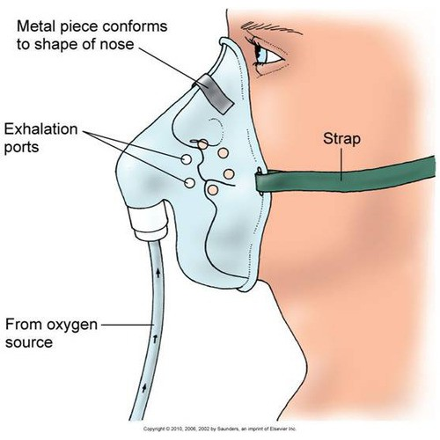
Simple Face Masks
Used for patients needing moderate oxygen flow (5-10L/min).
Proper fit is essential to prevent CO₂ rebreathing.
Minimum flow rate: 5L/min to clear exhaled CO₂.
Delivers FiO₂ up to 0.6 depending on flow rate.

Slide 12
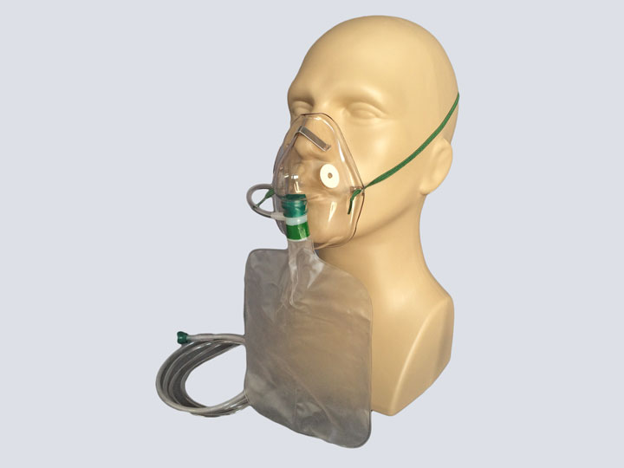
Non-Rebreather Masks
Provides nearly 100% oxygen concentration with a reservoir bag.
Ideal for acute hypoxemia or emergencies.
Ensure one-way valve functionality to prevent CO₂ rebreathing.
Useful for spontaneously breathing patients needing high FiO₂.
uncomfortable for prolonged use

Slide 13
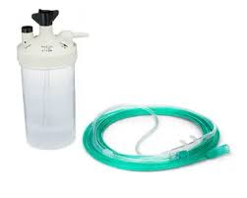
Traditional Nasal Cannulas
Comfortable and easy to use for low-to-moderate oxygen needs.
Flow rates limited to 6L/min to prevent dryness.
FiO₂ increases by 0.04 per liter of flow (up to 0.44 at 6L/min).
Best for patients who are stable and require low-flow oxygen.

Slide 14
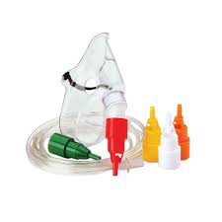
Venturi Oxygen Mask - Overview
Venturi Mask - Oxygen Delivery: 24%-50%
High-flow device providing precise oxygen concentrations.
Creates a high flow by mixing air and oxygen via the Venturi effect.
Use: For COPD patients needing controlled oxygen levels
Advantages & Limitations: Precise, non-invasive
may cause skin irritation with prolonged use.
Useful for adults and children; pediatric adapters available.
Notes:
Venturi Mask - Oxygen Delivery: 24%-50% based on selected color-coded adapter.

Slide 15
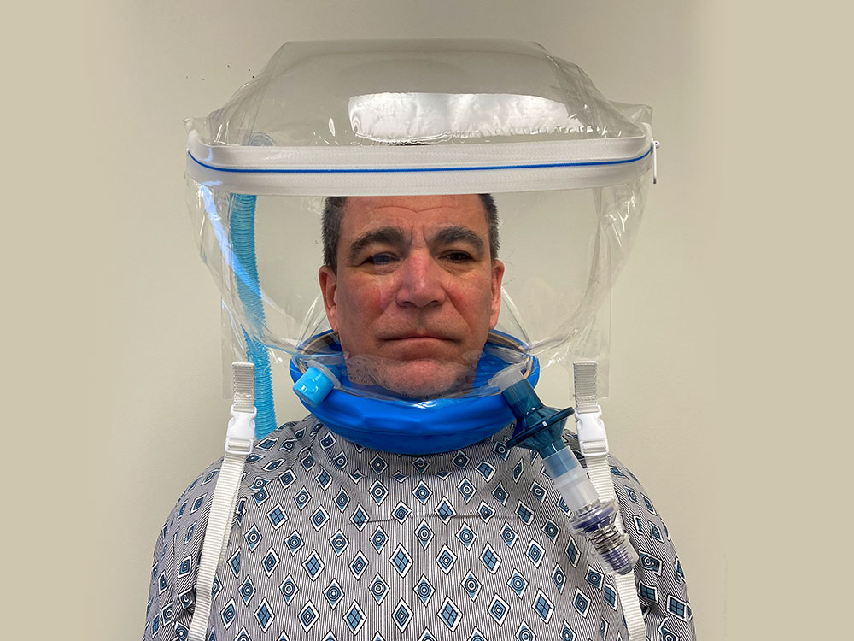
Head Tent - Overview
Provides 24%-80% humidified oxygen.
Surrounds head to deliver oxygen, mainly for pediatric use.
Ideal for children intolerant to masks, ensuring comfort.
Non-restrictive; potential CO2 buildup if not monitored.
Primarily for children; limited adult use due to size.
Allows head movement, reducing claustrophobia concerns.

Slide 16
Face Tent - Overview
Delivers 30%-70% oxygen, mixed with ambient air.
Non-constrictive device for patients with facial injuries.
Useful for trauma, burns, or claustrophobic patients.
Comfortable, less pressure; less precise oxygen levels.
Suitable for both Adults & Children
Provides humidified oxygen for better mucosal comfort.

Slide 17
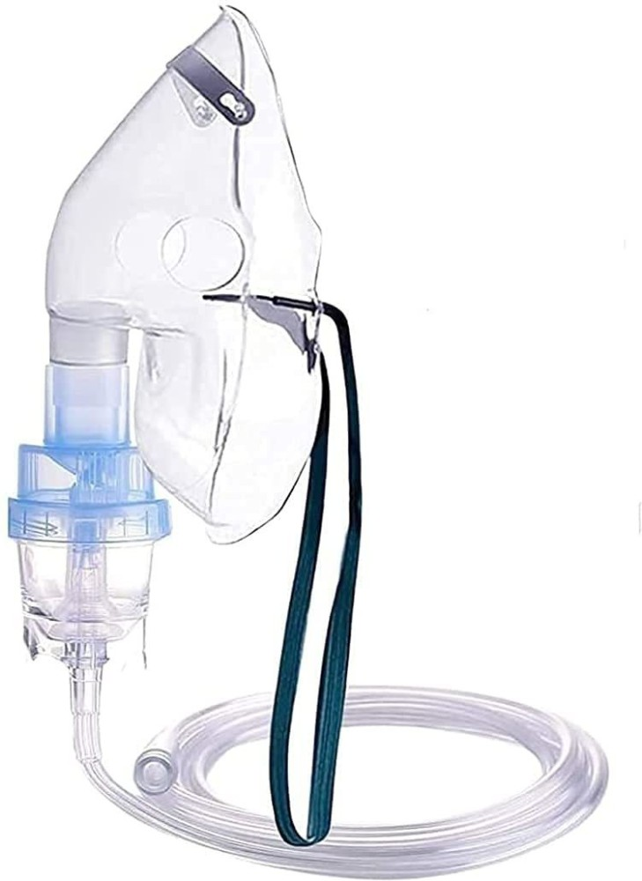
Nebulizer Oxygen Mask - Recovery Use
Provides 30%-50% oxygen while delivering medication.
Combines oxygen therapy with medication delivery.
for patients needing medication like bronchodilators.
Simultaneously delivers medication and oxygen
less precise oxygen control.
Beneficial for all ages
Ensures continuous delivery of medication to improve breathing post-op.
Notes:
Effective in recovery for patients needing medication like bronchodilators.
Beneficial for all ages, especially during recovery from respiratory conditions.
Particle Size of Medication in a Nebulized Oxygen Mask
In a nebulized oxygen mask, medications are delivered in the form of a fine mist (aerosol) that can be inhaled directly into the lungs. The particle size of the medication plays a crucial role in ensuring effective deposition in the airways and lungs.
Typical particle size range: 1 to 5 micrometers (µm).
Particles in this size range are optimal for lower respiratory tract deposition, including the bronchioles and alveoli.
Larger particles (>5 µm) tend to deposit in the upper airways (nose, mouth, throat) and may not reach the lower lungs effectively.
Smaller particles (<1 µm) may be exhaled without depositing in the lungs.
Importance of Particle Size in Nebulizer Therapy
Effective Deposition:
The 1-5 µm range is considered ideal for targeting the lower respiratory tract where conditions like asthma, COPD, and bronchiolitis occur.
Particles in this range can bypass the upper airways and reach deeper lung tissues.
Therapeutic Efficiency:
Medications like bronchodilators, corticosteroids, and antibiotics, when delivered in the optimal particle size range, ensure maximum therapeutic benefit with minimal waste.
Proper particle size improves drug absorption, leading to faster relief of symptoms like bronchospasm, wheezing, and airway inflammation.
Device Efficiency:
The efficiency of a nebulizer mask depends on its ability to generate particles within the ideal size range.
Devices that produce a higher percentage of particles in the 1-5 µm range are generally more effective for lower respiratory conditions.

Slide 18
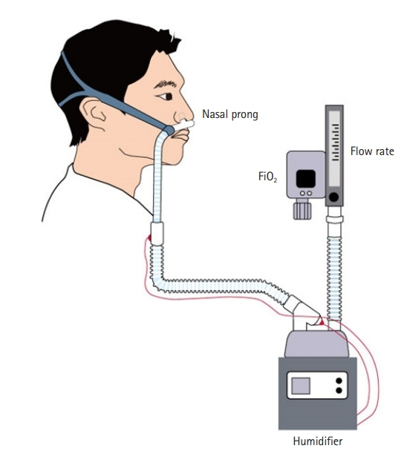
High-Flow Nasal Cannula (HFNC) Overview
Delivers oxygen at 40–60L/min with adjustable FiO₂
40%–100% O2 at 37°C and 99.9% relative humidity
Provides 99% humidity and warmth to improve airway comfort.
Suitable for patients with moderate hypoxemia without hypercapnia
Can provide a mild CPAP effect, reducing work of breathing

Slide 19
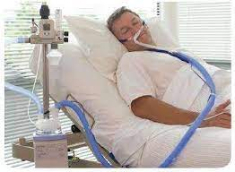
Benefits of HFNC
Reduces the need for mechanical ventilation.
Improves oxygenation in hypoxemic patients.
Provides comfort with humidified, heated air.
Effective for respiratory distress without intubation.
HFNC setup in ICU.

Slide 20
Continuous Positive Airway Pressure (CPAP)
CPAP improves alveolar recruitment and prevents atelectasis.
Enhances lung compliance and functional residual capacity.
Useful in patients with obesity or obstructive sleep apnea (OSA).
Effective for hypoxemia post-major surgery.

Slide 21
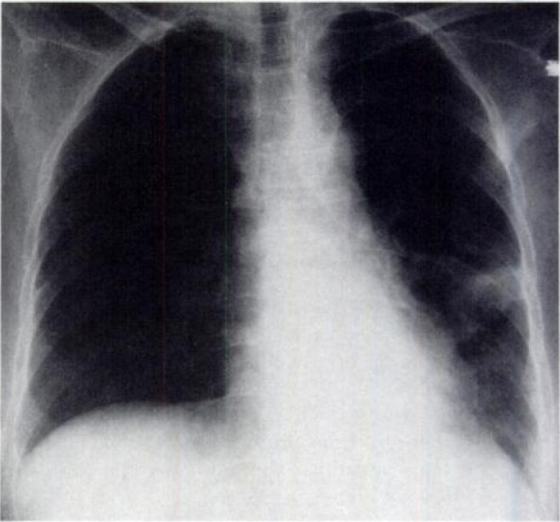
CPAP and Atelectasis
Postoperative atelectasis common due to pain and sedation.
CPAP helps reopen collapsed alveoli, improving gas exchange.
Reduces the risk of postoperative pneumonia.
Beneficial for patients with restricted lung function.
Notes:
respiratory failure in the immediate postoperative period is often due to transient and rapidly reversible conditions such as splinting from pain, diaphragmatic dysfunction, muscular weakness, and pharmacologically depressed respiratory drive. Readily reversible hypoxemia may be due to hypoventilation, atelectasis, or volume overload

Slide 22
CPAP Use in Bariatric Surgery
Obese patients benefit from CPAP post-surgery to prevent hypoxemia.
No increased risk of anastomotic leaks found with CPAP.
Improves oxygenation without stomach inflation.
Studies confirm CPAP safety in bariatric cases.
Notes:
Yet surgeons were initially hesitant to embrace this modality for fear that applying positive pressure to the airway would inflate the stomach and proximal intestine and result in anastomotic disruption

Slide 23
Noninvasive Positive-Pressure Ventilation (NIPPV)
Provides additional support for patients not responding to CPAP.
Effective for COPD, OSA, and pulmonary edema management.
Can prevent the need for invasive intubation.
Delivered via face mask or nasal interface.

Slide 24
Indications for NIPPV
Ideal for COPD exacerbations, OSA, and cardiogenic pulmonary edema.
Supports spontaneous breathing while increasing alveolar pressure.
Enhances ventilation without invasive intubation.
Useful post-extubation to prevent respiratory failure.

Slide 25
Contraindications for NIPPV
hemodynamic instability or life-threatening arrhythmia
Not suitable for patients with altered mental status
High aspiration risk patients
those unable to protect their airway.
inability to use nasal or facial mask (head and neck procedures)
refractory hypoxemia
Requires patient cooperation for effective use

Slide 26
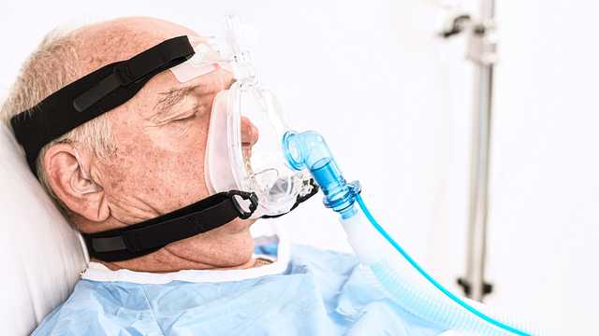
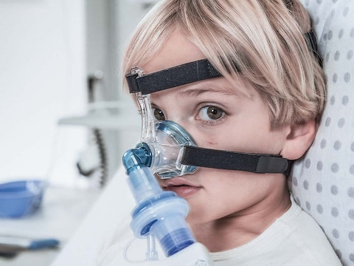
NIPPV

Slide 27
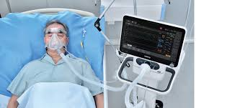
Success Factors for NIPPV
Best outcomes in patients who are alert and cooperative.
Moderate hypercarbia (PaCO₂ 45-92 mmHg) improves with NIPPV.
Quick improvement within 2 hours is a positive indicator.
Requires continuous monitoring and adjustment.

Slide 28
Preventing Postoperative Respiratory Failure
Early use of NIPPV reduces the risk of atelectasis.
Beneficial for high-risk surgical patients, especially after thoracic surgery.
Enhances recovery by improving oxygenation and reducing fatigue.
Supports smooth transition from mechanical ventilation.

Slide 29
Prophylactic Use of NIPPV
Useful in bariatric, thoracic, and vascular surgeries to prevent complications.
Reduces risk of reintubation and pulmonary complications.
Tailored protocols based on patient risk profiles.
Enhances recovery and reduces ICU stay duration.

Slide 30
Post-Extubation Use of NIPPV
Supports patients transitioning off mechanical ventilation.
Reduces the incidence of post-extubation respiratory distress.
Particularly effective in patients with underlying lung disease.
Can prevent the need for reintubation.

Slide 31


